Slide 1
Gradient Boosting

Slide 2
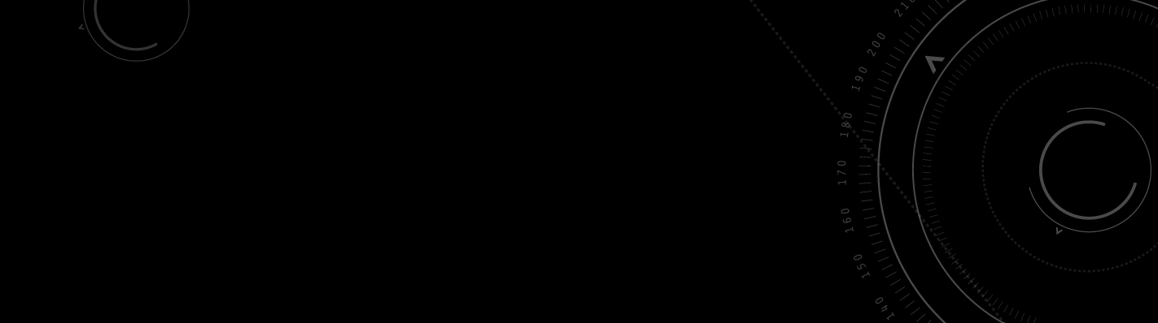
Boosting
Boosting can be referred to as a set of algorithms whose primary function is to convert weak learners to strong learners. They have become mainstream in the Data Science industry because they have been around in the machine learning community for years.

Slide 3
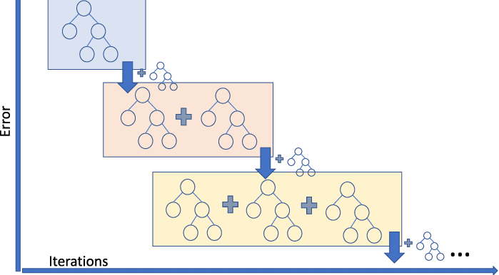
Gradient Boosting
In the gradient boosting algorithm, we train multiple models sequentially, and for each new model, the model gradually minimizes the loss function using the Gradient Descent method. It is sequentially built because, for each new tree, the model considers the errors of the last tree, and the decision of every successive tree is built on the mistakes made by the previous tree.

Slide 4
How Gradient Boosting Works
Gradient boosting involves three elements:
A loss function to be optimized.
A weak learner to make predictions.
An additive model to add weak learners to minimize the loss function.

Slide 5
1. Loss Function
The loss function used depends on the type of problem being solved.
It must be differentiable, but many standard loss functions are supported, and you can define your own.
For example, regression may use a squared error and classification may use logarithmic loss.

Slide 6
2. Weak Learner
Decision trees are used as the weak learner in gradient boosting.
Specifically, regression trees are used that output real values for splits and whose output can be added together, allowing subsequent models outputs to be added and “correct” the residuals in the predictions.
Initially, very short decision trees were used that only had a single split, called a decision stump.

Slide 7
3. Additive Model
Trees are added one at a time, and existing trees in the model are not changed.
A gradient descent procedure is used to minimize the loss when adding trees.
Traditionally, gradient descent is used to minimize a set of parameters, such as the coefficients in a regression equation or weights in a neural network. After calculating error or loss, the weights are updated to minimize that error.

Slide 8
3. Additive Model
Instead of parameters, we have weak learner sub-models or more specifically decision trees. After calculating the loss, to perform the gradient descent procedure, we must add a tree to the model that reduces the loss (i.e. follow the gradient). We do this by parameterizing the tree, then modify the parameters of the tree and move in the right direction by (reducing the residual loss.

Slide 9
Improvements to Basic Gradient Boosting
Gradient boosting is a greedy algorithm and can overfit a training dataset quickly.
It can benefit from regularization methods that penalize various parts of the algorithm and generally improve the performance of the algorithm by reducing overfitting.
There are 4 enhancements to basic gradient boosting:
Tree Constraints
Shrinkage
Random sampling
Penalized Learning

Slide 10
Tree Constraints
A good general heuristic is that the more constrained tree creation is, the more trees you will need in the model.
There is some constraints that can be imposed on the construction of decision trees:
Number of trees: keep adding trees until no further improvement is observed.
Tree depth: better results are seen with 4-8 levels.
Number of nodes or number of leaves: constrained to a symmetrical structure if other constraints are used.
Number of observations per split: imposes a minimum constraint on the amount of training data at a training node before a split can be considered
Minimim improvement to loss: is a constraint on the improvement of any split added to a tree.

Slide 11
2. Shrinkage
The predictions of each tree are added together sequentially.
The contribution of each tree to this sum can be weighted to slow down the learning by the algorithm. This weighting is called a shrinkage or a learning rate.

Slide 12
3. Random sampling
A big insight into bagging ensembles and random forest was allowing trees to be greedily created from subsamples of the training dataset.
This same benefit can be used to reduce the correlation between the trees in the sequence in gradient boosting models.
This variation of boosting is called .

Slide 13
4. Penalized Learning
Classical decision trees like CART are not used as weak learners, instead a modified form called a regression tree is used that has numeric values in the leaf nodes (also called terminal nodes). The values in the leaves of the trees can be called weights in some literature.
As such, the leaf weight values of the trees can be regularized using popular regularization functions, such as:
L1 regularization of weights.
L2 regularization of weights.

Slide 14
2. Shrinkage
The predictions of each tree are added together sequentially.
The contribution of each tree to this sum can be weighted to slow down the learning by the algorithm. This weighting is called a shrinkage or a learning rate.

